Slide 1

Grid & Flexbox Layout A Review

Slide 2
Grid Layout

Slide 3
Grid Layout
Grid layout is for a full web page or a large section of a web page.
Download “Review Code” zip from Brightspace
Create a grid of 3 rows and 2 columns
Put grid-container class in CSS
Put grid-container class in HTML

Slide 4
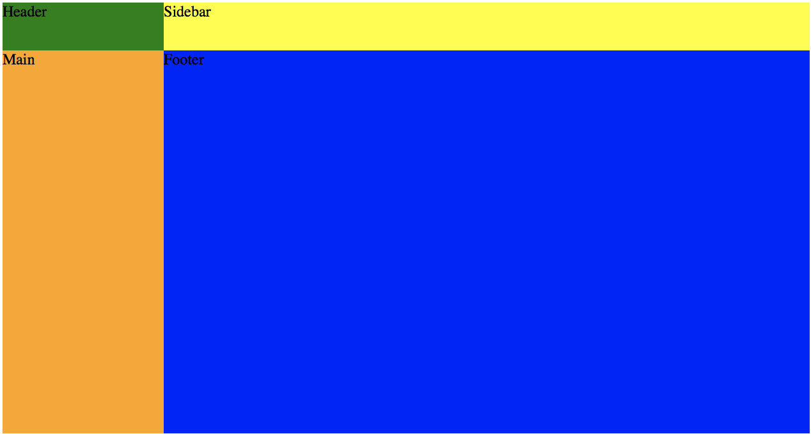
Create a grid..
It should look like this when rendered.

Slide 5
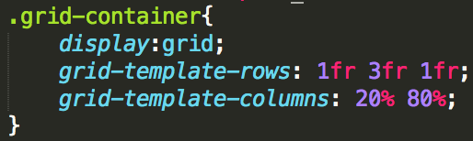
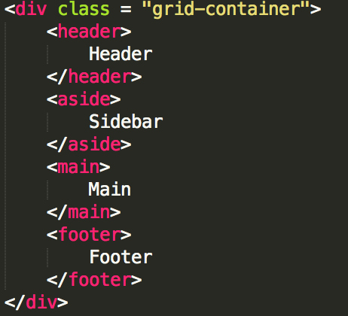
Code for creating a grid..
CSS
HTML

Slide 6
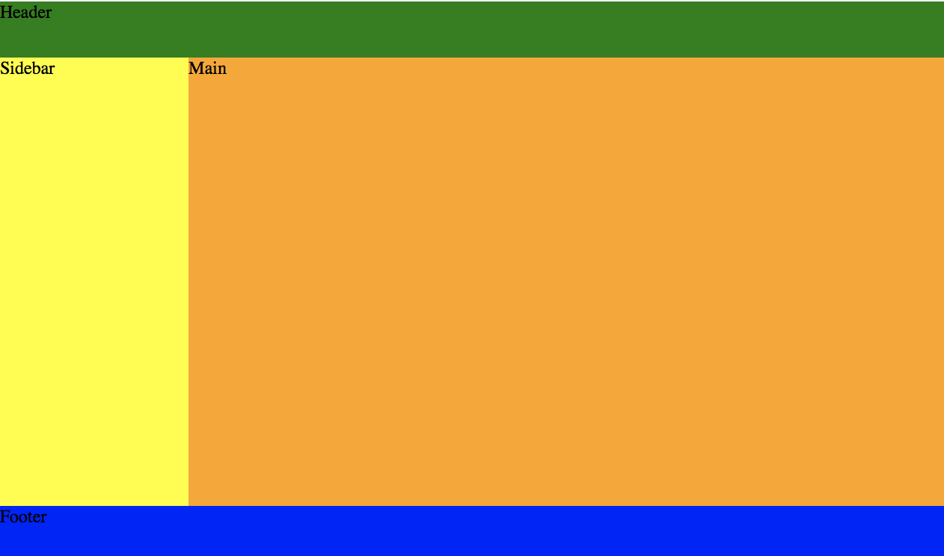
We want to span columns..
However, I wanted it to look like this – 3 rows, 2 columns

Slide 7
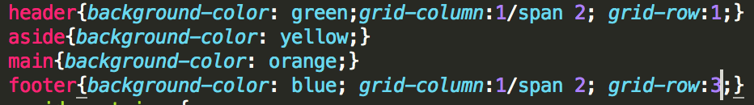
Code for spanning columns..
CSS

Slide 8
Flexbox Layout

Slide 9
How do I align content in a layer?
Flexbox is used for aligning within a layer.
Each layer below has been aligned with flexbox
header, aside, main: centered horizontally and vertically
footer has been aligned to the right

Slide 10
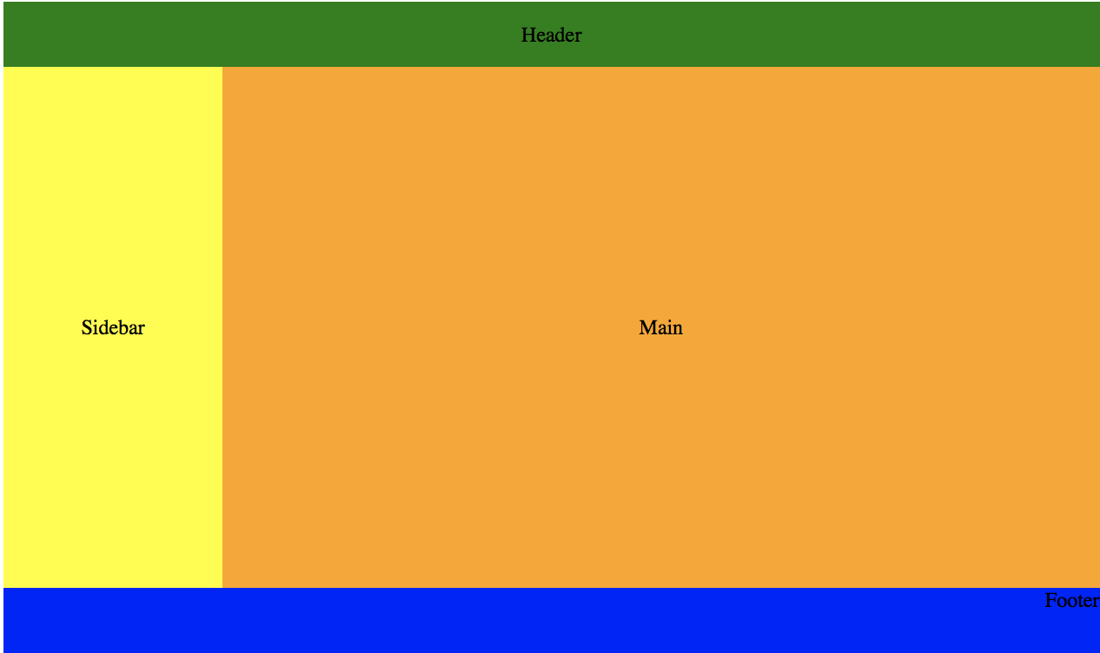
Flexbox Layout Module

Slide 11
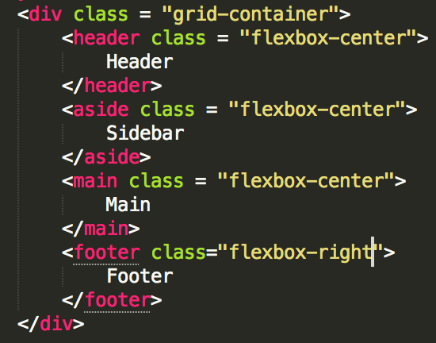
Each layer has been aligned using Flexbox..
HTML
CSS

Slide 12
How can I make this responsive?

Slide 13

Desktop -> Mobile

Slide 14
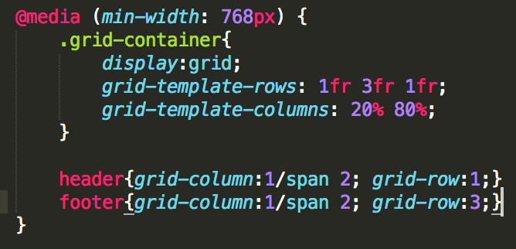
Put all layout code into an @media..
CSS

Slide 15
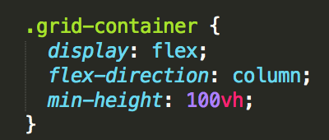
Code the layout for the mobile ..
CSS

Slide 16
Some good resources..
A Complete Guide to FlexBox - https://css-tricks.com/snippets/css/a-guide-to-flexbox/
CSS Grid Layout - https://developer.mozilla.org/en-US/docs/Web/CSS/CSS_Grid_Layout

